Slide 1
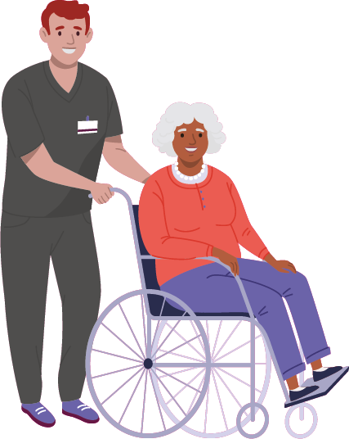

Slide 2
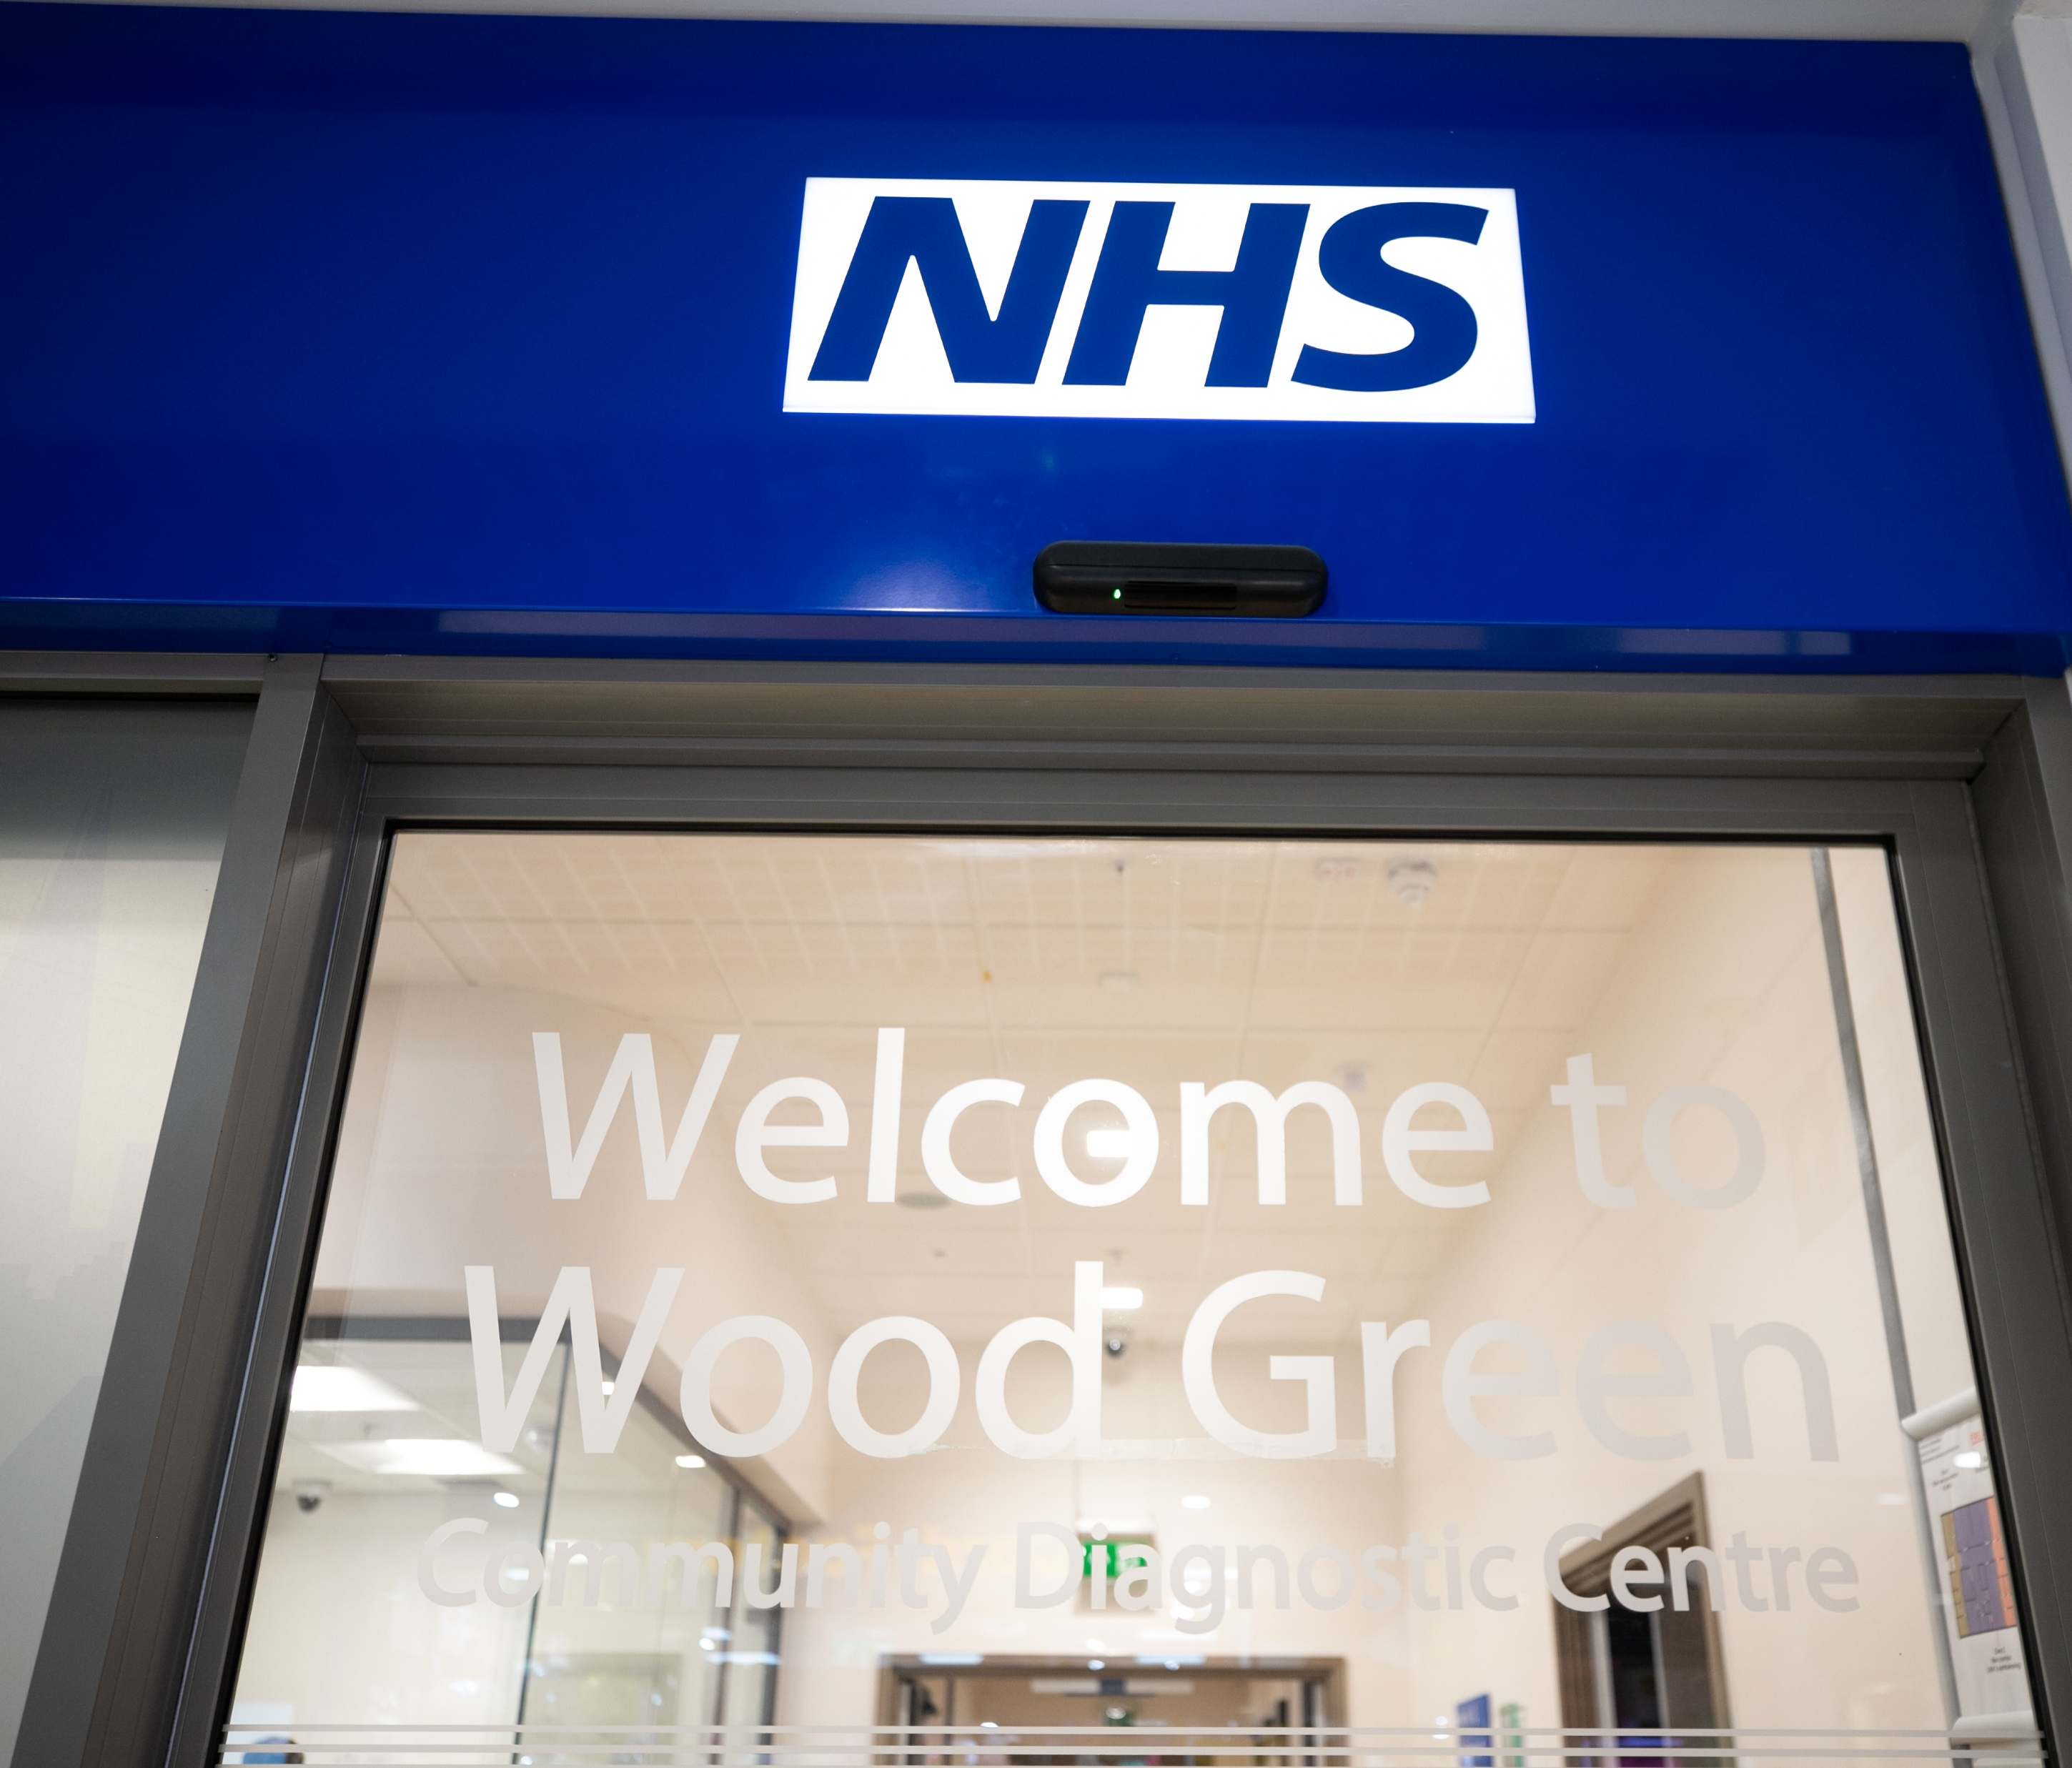
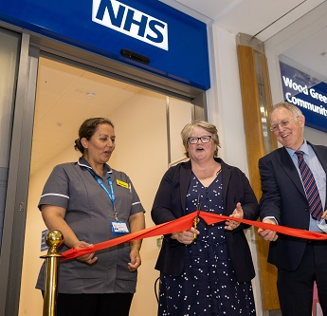
Background
Bringing diagnostic testing into the heart of Haringey, a borough which does not have a hospital.
Over 46,000 patients seen since opening in August 2022.
Hosted by Whittington Health NHS Trust, this community site is closer than the neighbouring acute sites for 30 out of 40 GP practices in the borough.
Services provided include X-Rays, Ultrasounds, Blood Tests and Eye Tests.
Introduction of CT and MRI scans in December 2023.

Slide 3
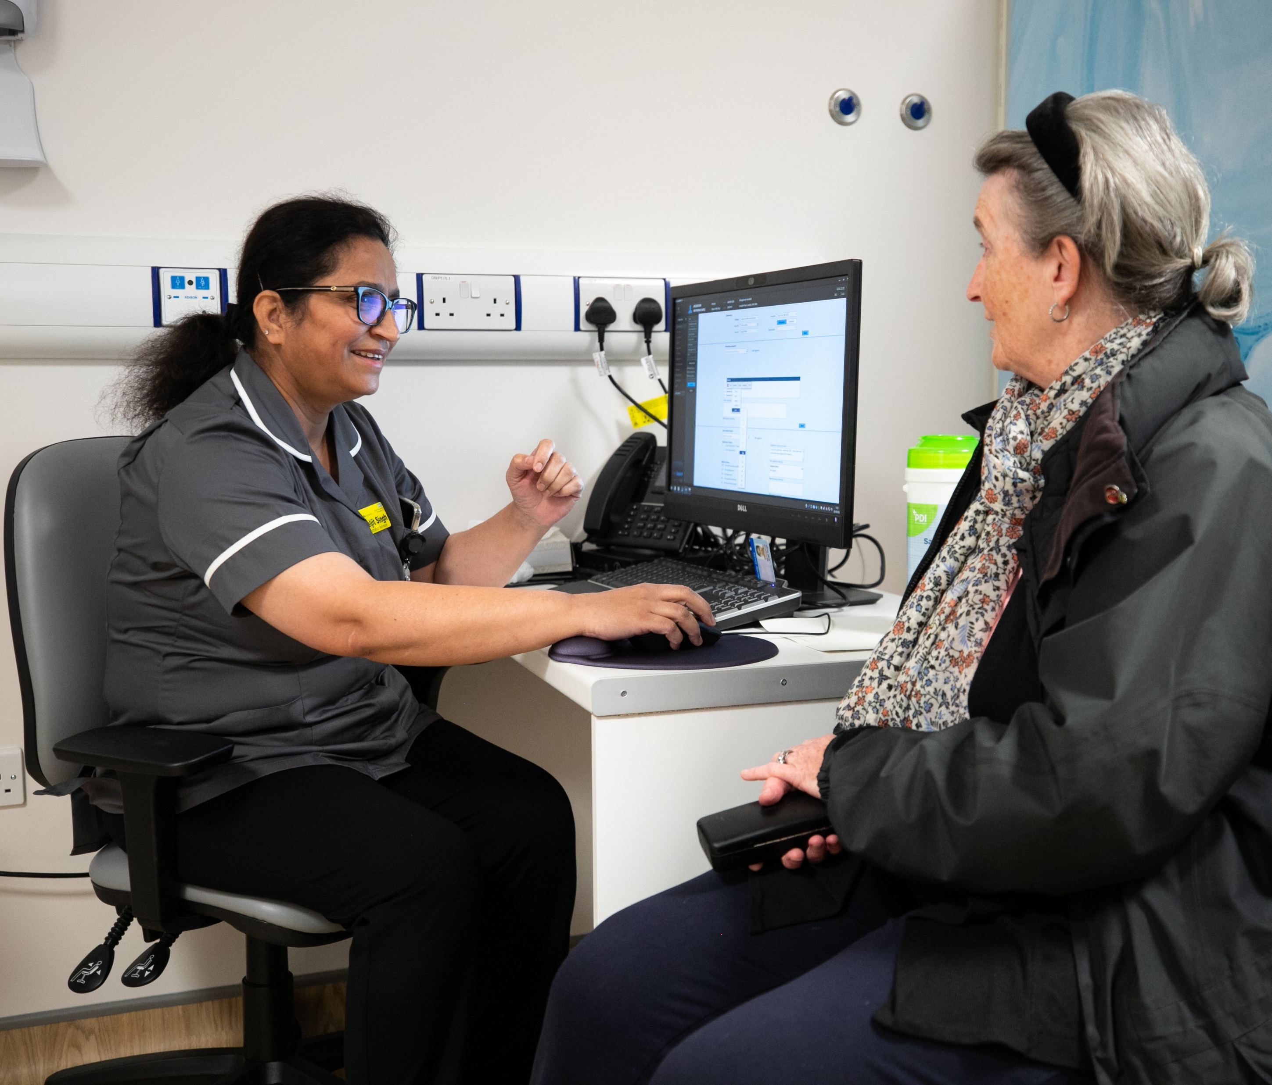
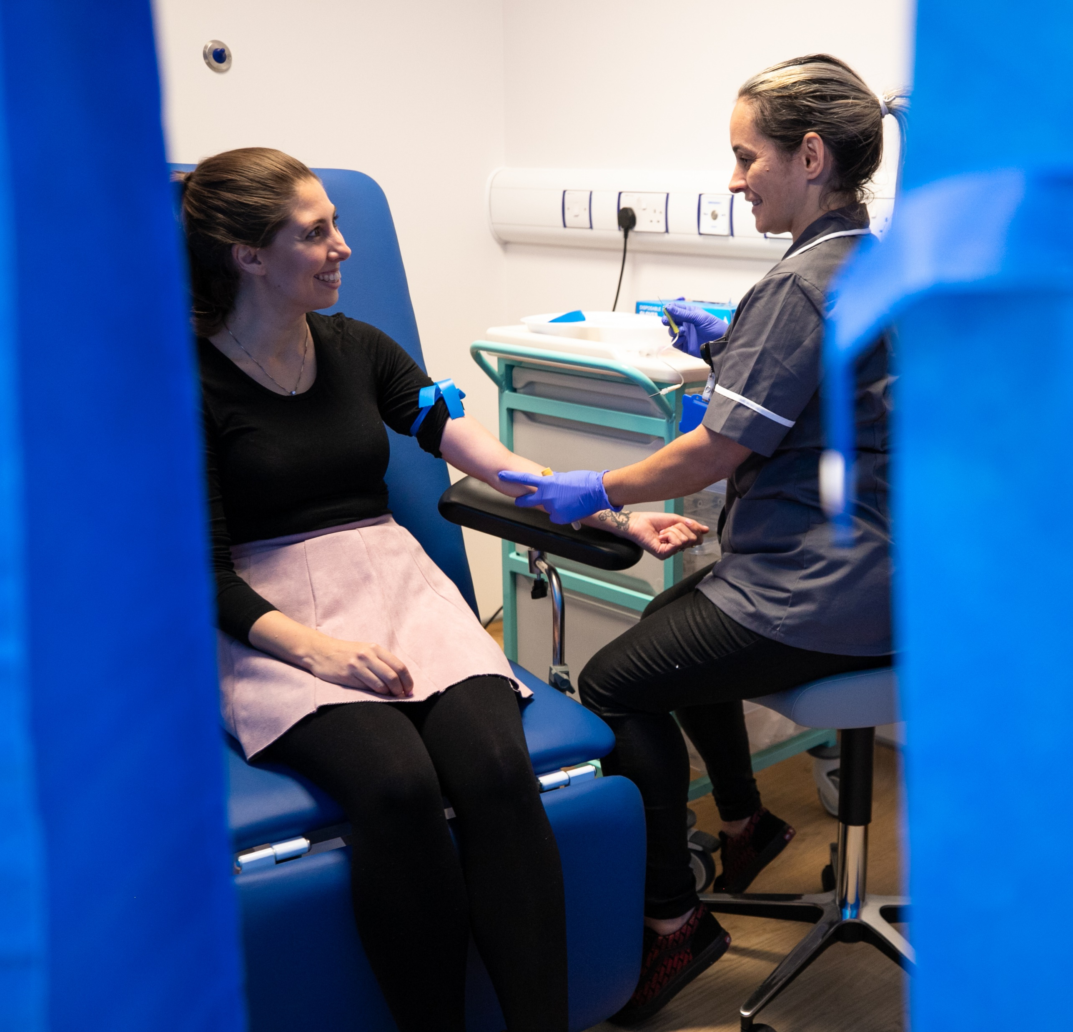
Aims
Supporting the integration of care
Delivering a better and more personalised experience
Improving population health outcomes
Increasing diagnostic capacity
Improving productivity and efficiency
Contributing to reducing health inequalities

Slide 4
Health on the High Street
* Ctrl + click the image above to view a short video online.

Slide 5
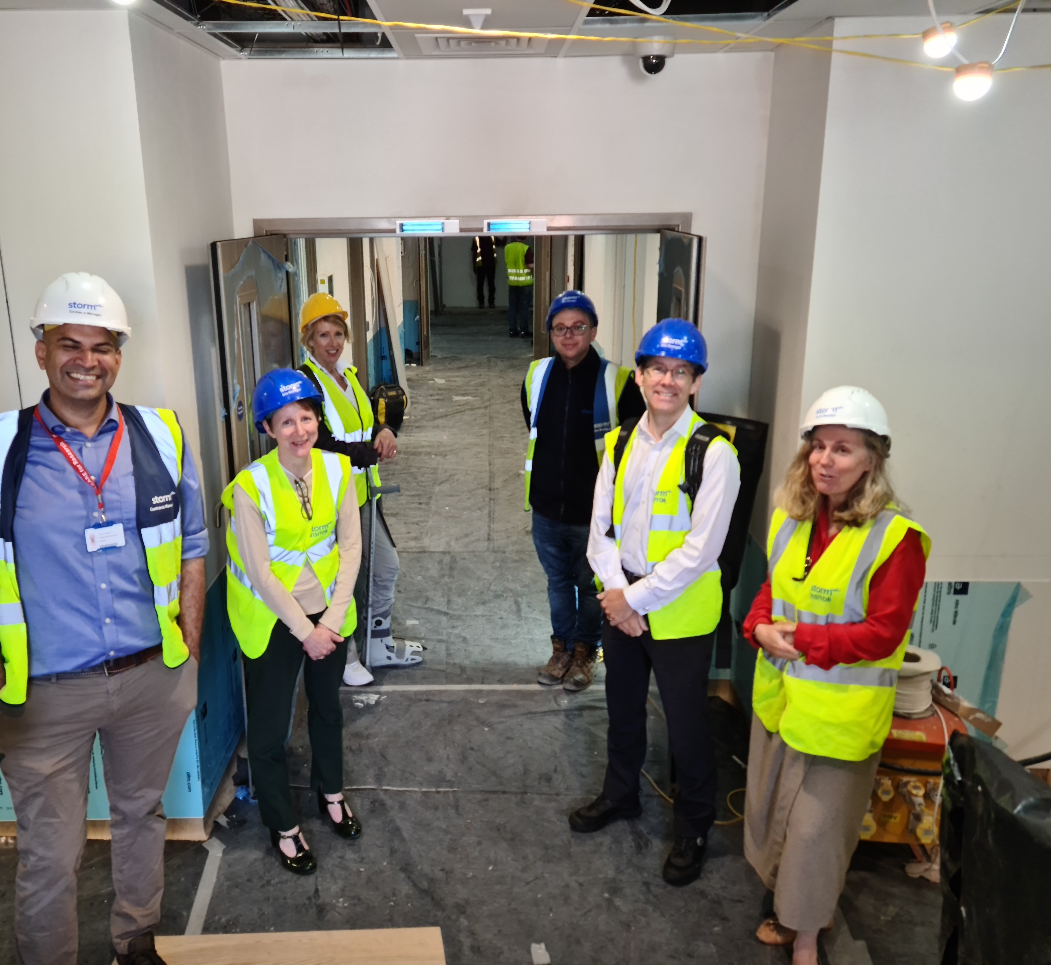
Location
Two retail units in The Mall Wood Green were refurbished into a diagnostic facility.
Provides diagnostic testing closer to home.
Multiple public transport links into Wood Green.

Slide 6
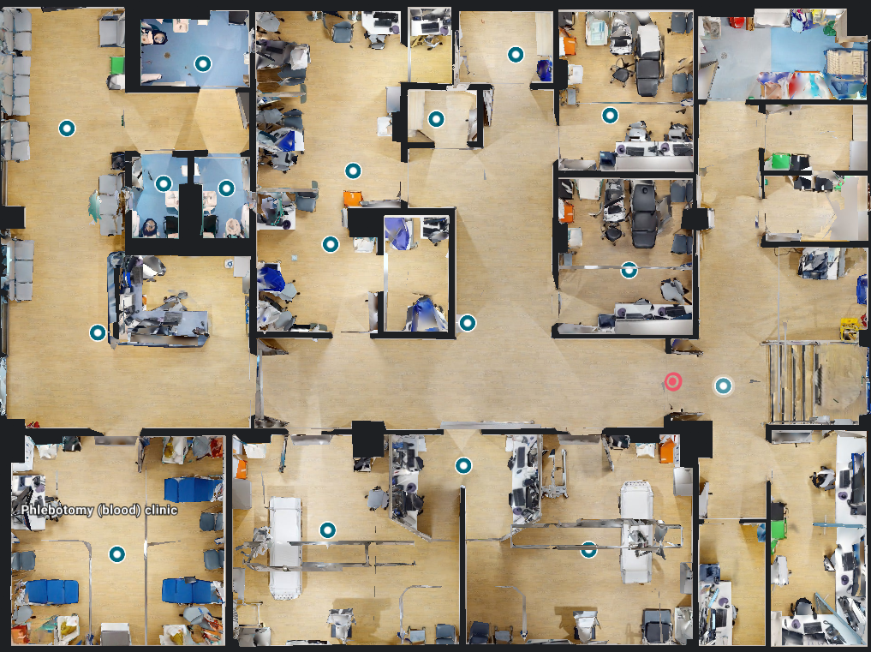
Ground Floor Layout
Works are currently underway to transform the basement of the unit into the Lower Ground Floor.
This will include CT and MRI suites, offices, and more staff and patient facilities.
Ultrasound 1
Ophthalmology
Ultrasound 2
Phlebotomy
X-ray 1
X-ray 2

Slide 7
Referral Sources
Whittington Hospital
North Middlesex Hospital
The Royal Free Hospital
Barnet & Chase Farm Hospitals
UCLH
GPs (from all across NCL)
Non Medical Referrers

Slide 8
Reporting Turnaround Times (RTT)/Results
Ultrasound – 1 week
X-ray – 2days
Phlebotomy – 3-5days
Ophthalmology – 3 weeks

Slide 9
Challenges
IT systems
Raising profile
Ongoing building works
Waiting times onsite
Evolving services – new pathways/ changing how we work

Slide 10
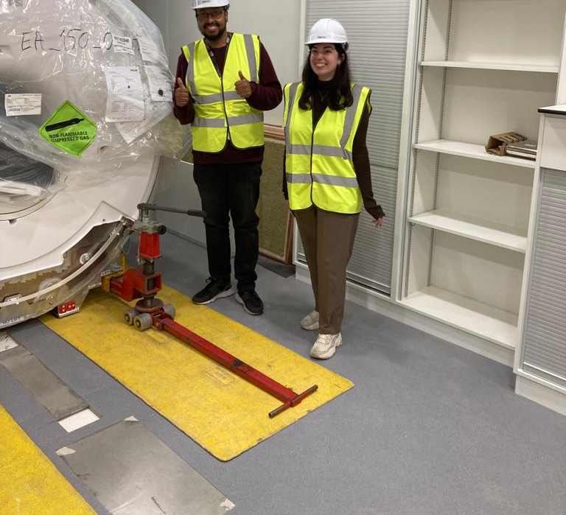
Phase II

Slide 11
How to Access the CDC
Woodgreencdc.whithealth@nhs.net
Enquiries.woodgreencdc@nhs.net
020 7288 5626
Ground Floor (Units 51-53), The Mall, 159 High Road, Wood Green, London, N22 6YD

Slide 12
Questions?

