Slide 1
Phase 2 – July 2021

Slide 2
Vaccine Survey: Phase 1
Online survey exploring Haringey residents’ attitudes to the Covid-19 vaccine:
Whether people were planning to have the vaccine,
Their motivations for having the vaccine, and
Their concerns and anxieties about the vaccine
Survey ran throughout January and February 2021, when the vaccine was first being rolled out to older people
445 respondents – mix of gender, age, ethnicity, ward
Significant variation in vaccine hesitancy amongst Haringey’s diverse communities, with ethnic minorities (people of colour) and especially Black communities being much more hesitant about having the vaccine
Our findings helped shape communications and engagement around the Covid-19 vaccine, identifying communities where more work needed to be done to encourage people to take up the vaccine:
Walk-in/pop-up clinics in community venues, translating information into community languages, link workers engaging with specific communities

Slide 3
Vaccine Survey: Phase 2
Follow-up work (focus groups and 1-2-1 phone interviews) with communities who were more vaccine hesitant to explore what was holding them back and whether they would be willing to change their minds
Four communities:
Young people – only three 18 to 24 year olds completed our online survey and the vaccine rollout would be reaching young people in the Summer
Eastern European – we had no responses to our online survey from these communities
Black African – Black communities had been highlighted as much more vaccine hesitant through our online survey
Black Caribbean – Black communities had been highlighted as much more vaccine hesitant through our online survey
Today: Presenting our findings on young people (this work is complete) and Eastern European communities (interim findings)

Slide 4
Key Topics / Themes
Vaccine Hesitancy
If you are not planning to have the vaccine/are unsure about having the vaccine - Why is that? Key reasons stopping you having the vaccine?
Are you willing to change your mind? What would make you change your mind and encourage you to have the vaccine?
Other considerations
Family
Travel
Information
Where have you seen/where do you get information on Covid-19?
Who do you trust for reliable information on Covid-19?
What further information/support do you want/need which would make you more likely to have the vaccine?

Slide 5
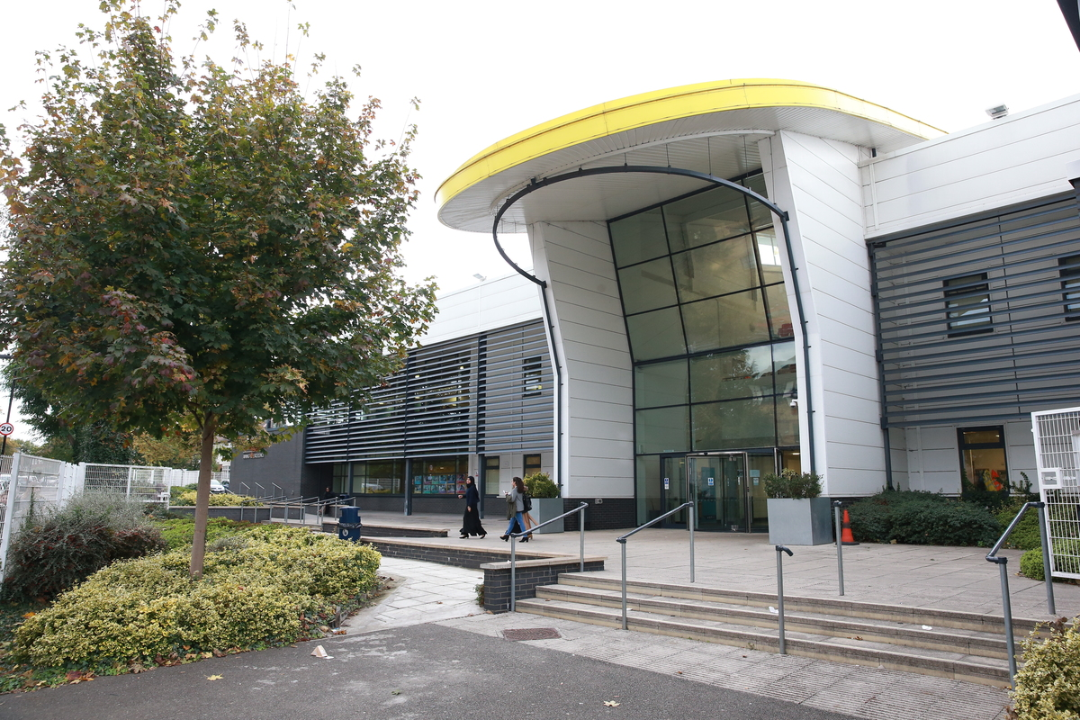
Young people – Work complete
Haringey 6th Form College
Students aged 18 to 30 years of age
3 focus groups on Zoom – 5/6 students per focus group
Young men and young women (mostly young men)
Ethnically diverse (mostly Black)

Slide 6
Young people – Motivations
Young people did not see the vaccine as something they needed or that was helpful or useful to them
Young people willing to have the vaccine:
Doing it for the sake of the community “public good” as they want to play their part in keeping people safe
Wanting to keep older family members safe eg grandparents
Wanting to keep family safe
They themselves are clinically vulnerable or live with family members who are clinically vulnerable
Offered the vaccine and no reason to refuse
Family members
had the vaccine and were OK which was reassuring, and
encouraged them to have the vaccine

Slide 7
Young people – Vaccine hesitancy
Young people did not see the vaccine as something they needed or that was helpful or useful to them.
Young people not willing to have the vaccine:
No need to have the vaccine – young, healthy, strong immune system
Do not trust the vaccine - developed too quickly, not been tested enough, concerns around ingredients, anxieties around side effects, worry about long-term effects, will it work against new variants?
Do not trust information on vaccine – Media and Government have their own agenda, selling a particular narrative, keeping things from the public
Adamant they would not have the vaccine and not willing to change their minds
Feel the vaccine is for older people and those who are clinically vulnerable - recommended these people have the vaccine!

Slide 8
Young people – Travel
Travel was the one thing that would encourage young people unwilling to have the vaccine to have the vaccine – if they needed the vaccine to travel they would have it
Not all young people were planning to travel abroad at present – plenty to see and do within the UK and even within London
Note:
When we did this work, vaccine passports were only being considered for travel overseas and so we asked specifically about travel. Now they are being considered for access to nightclubs, Premier League football, etc. Young people may have the vaccine if they need the vaccine to access these venues

Slide 9
Young people - Information
Where have you seen / where do you get information on Covid-19?
Social media – WhatsApp, Instagram, Snapchat, Twitter, Facebook
News – TV, online
Friends and family
Internet
Who do you trust for reliable information on Covid-19?
News – Although they were very clear media has an agenda, and a narrative they are pushing - they have this in mind when they watch/read news and so don’t take media reports at face value
Medical professionals, doctors, GPs, Medical articles
Statistics
Scientists
Friends and Family
People with experience of having the vaccine
Distrust of Government and a feeling some information is not being shared and things are being kept from the public

Slide 10
Young people - Information
What further information/support do you want/need which would make you more likely to have the vaccine?
On the whole, content with the information they have
Case studies and stories of real people having the vaccine
More information on vaccine:
Has it been tested enough?
Is it safe for young people?
Ingredients?
Side effects?
Long-term effects?
Will it work against new variants?
Trusted site where there was accurate and up-to-date information, FAQs etc – young people did not really know where best to go to get this information

Slide 11
Eastern European – Interim findings
Referrals came from:
House of Polish & European Community (HoPEC) – Polish residents
Florence Guppy – Hungarian and Romanian residents
4 Polish women, 1 Hungarian man
Polish women – text interviews – late 40s, 50, early 60s
Hungarian man – phone interview – late 40s
4 out of the 5 people we spoke to had the vaccine, and findings need to be seen in the light of this

Slide 12
Eastern European – Vaccine hesitancy
Real anxiety and worry about the vaccine:
Is it safe?
Has it been tested properly?
Side effects?
Long-term effects?
Pros and cons of different vaccines – why is one not safe for younger people?
Other reasons for vaccine hesitancy:
Wanting to “wait and see” if it is safe – delaying having the vaccine until others have had the vaccine and you can see how they get on
Even after having the vaccine you can still get Covid-19, get very sick, be in hospital and die so what’s the point?
I am healthy and taking precautions (eg sanitising hands, wearing mask, practising social distancing) so why do I need a vaccine?

Slide 13
Eastern European – Motivations
Family is a real motivating factor for getting the vaccine:
Wanting to protect the family
Not wanting the family to get sick
Needing to be well to care for the family
Children at school, and people at school getting sick with Covid-19
Being able to see grandchildren
Family members having the vaccine and having a positive experience
Other key reasons for having the vaccine:
Work – commuting to and from work, being at work, exposing you to more risk
Wanting to go out and about again eg shopping, going to the pub
Prevents serious illness and death
Protecting wider community
Having an underlying health condition / being clinically vulnerable

Slide 14
Eastern European – Information
News - TV, papers, online
Talking to family, friends, community networks
Listening to the experience of family and community members who have had the vaccine
PM Conferences / briefings
Online GP Q&As

Slide 15
Vaccine Survey: Phase 2 Summary findings – Young people
Young people did not see the vaccine as something they needed or that was helpful or useful to them
Those willing to have the vaccine were doing it to protect their family, older family members, clinically vulnerable, wider community “public good”; or because family members had had the vaccine and were OK which was reassuring, and family members encouraged them to have the vaccine
Those not willing to have the vaccine felt they did not need it as they were young, healthy and had a strong immune system; they did not trust the vaccine; did not trust Government and media information on vaccine as they had their own agenda; and were adamant they would not have the vaccine and were not willing to change their minds
Travel was the one thing that would encourage young people unwilling to have the vaccine to have the vaccine – if they needed the vaccine to travel, they would have it
Whilst young people got a lot of information through social media and online; they trusted news (whilst appreciating media has an agenda), factual information (doctors, GPs, scientists, statistics), friends and family, and people who have had the vaccine

Slide 16
Vaccine Survey: Phase 2 Interim findings – Eastern European
Real anxiety and worry about the vaccine - Is it safe? Has it been tested properly? Side effects? Long-term effects? Pros and cons of different vaccines?
Wanting to “wait and see” if it is safe – delaying having the vaccine until others have had the vaccine and you can see how they get on
Even after having the vaccine you can still get Covid-19, get very sick, be in hospital and die so what’s the point?
I am healthy and taking precautions (eg sanitising hands, wearing mask, practising social distancing) so why do I need a vaccine?
Family is a real motivating factor for getting the vaccine: Wanting to protect the family, Not wanting the family to get sick, Needing to be well to care for the family, Children at school and people at school getting sick with Covid-19, Being able to see grandchildren, Family members having the vaccine and having a positive experience
Other key reasons for having the vaccine: Work, Commuting, Wanting to go out and about again, Being clinically vulnerable, Prevents serious illness and death, Protecting wider community

Slide 17
Phase 2 – July 2021

