Slide 1
Whittington Health
Haringey Patient Participation Group
19th June 2021

Slide 2
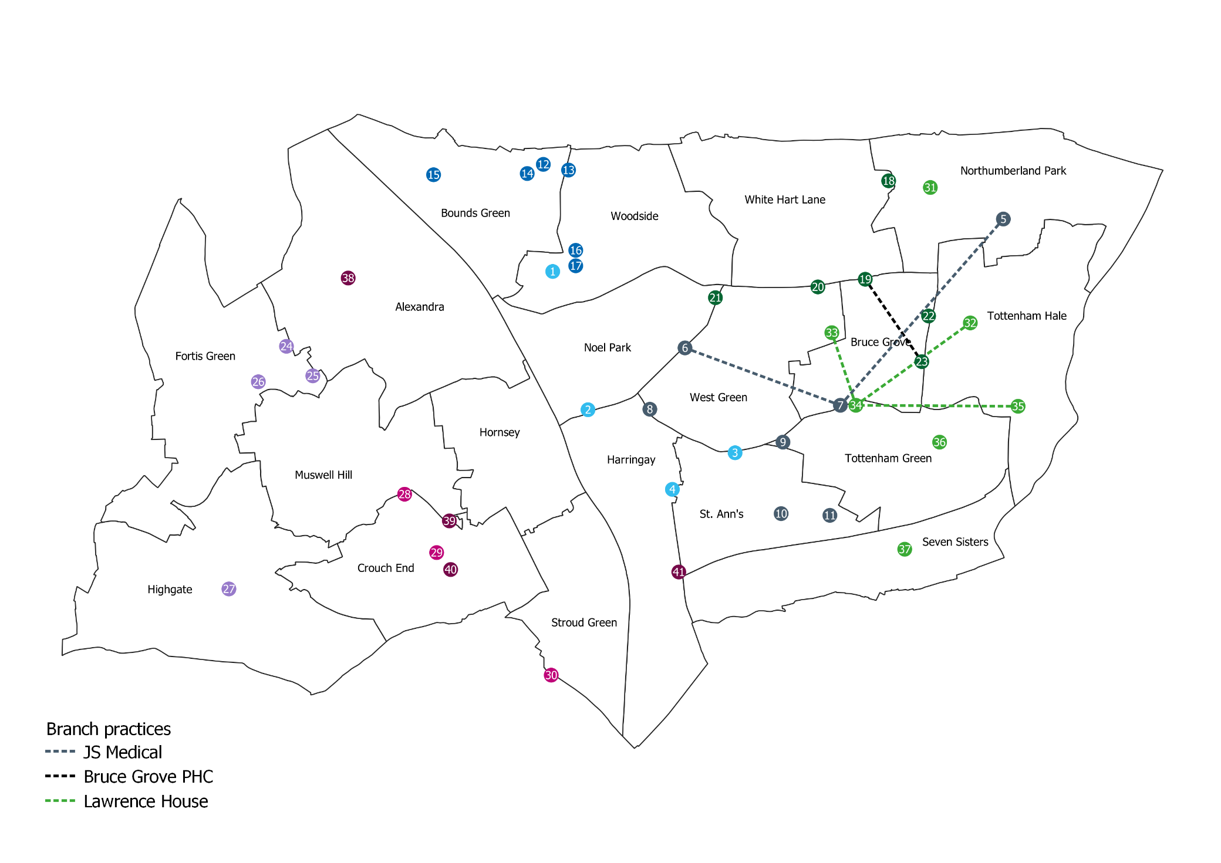
Localities Based on Redrawn Collaboratives
NMUH
Central Locality: 114k
East Locality: 102k
West Locality: 108k
Whit

Slide 3
Whittington Health Adult
Community Services
Urgent Response
Rapid Response
Integrated Discharge Teams
Rehabilitation
District Nurse Assessment
Early Stroke Discharge
Anticipatory Care
Multidisciplinary Team Teleconference
Frailty Service
HCAPS
Community Matrons
Enhanced Health Care Homes
Long Term Conditions & Self management
Therapies
Podiatry
Musculoskeletal Service
Nutrition and Dietetics
Central Booking service
Mobility and Seating
Localities
District Nursing
Slow stream rehabilitation
Blue Basde Assessments
Intermediate Diabetes
Heart Failure
Lymphoedema
Respiratory
Self management
Bladder and Bowel
IAPT
Continuing HealthCare (CHC)

Slide 4
Children and Young People’s Services in Haringey
We provide a wide range of community health services for children and young people (CYP) in Haringey. Services provided include:
We provide Universal Services that are for all CYP, e.g. health visiting, as well as services that are targeted and specialist, e.g. services for children with complex needs.
Services are provided in a wide range of locations across the borough including in schools, children centres, health centres, homes and other community venues. A very important part of CYP service provision is local delivery. We work across the borough in partnership with and alongside schools, social care and other providers
Health visiting | School Nursing
Community Paediatrics | Physiotherapy
Parent Infant Psychology | Occupational Therapy
Speech and Language Therapy | Nutrition & Dietetics
Children’s Nursing | Children in Care

