Slide 1
NCL CCG update
24 June 2021

Slide 2
Integrated Care System
Integrated care systems (ICSs) are partnerships that bring together providers and commissioners of NHS services across a geographical area with local authorities and other local partners to collectively plan health and care services to meet the needs of their population. The central aim of ICSs is to integrate care across different organisations and settings, joining up hospital and community-based services, physical and mental health, and health and social care.
ICSs are intended to bring about major changes in how health and care services are planned, paid for and delivered, and are a key part of the future direction for the NHS as set out in the NHS Long Term Plan. It is hoped that they will be a vehicle for achieving greater integration of health and care services; improving population health and reducing inequalities; supporting productivity and sustainability of services; and helping the NHS to support social and economic development

Slide 3
How we are already working like an ICS
Despite all of the challenges of the past 18 months, we have still managed to build stronger partnerships, relationships, and new ways of working as a system across social, primary and secondary care organisations.
This year informally made us think and act more like an integrated care system, aiming to deliver the best and seamless care for our population through the pandemic. We have already started focusing work on a number of areas.
A move to single strategic commissioner for health services.
Ensuring resident voice is heard at all levels of work.
Establishing five borough-based integrated care partnerships focused on the coordination, integration and development of out of hospital services based on population needs.
Supporting the development of Primary Care Networks.
Through our response to and recovery from the Covid-19 pandemic we have worked collaboratively through the Clinical Advisory Group and ‘GOLD’ decision-making executive. We have worked increasingly as a system to tackle challenges and find solutions to meet the needs of local people.
A recent successful example that shows how we work across different levels of a system effectively, is our Covid-19 vaccination programme, where enablers such as HealtheIntent are supporting our system response, boroughs deploy their local know-how to plan for delivery based on local needs; while neighbourhood pharmacies and PCNs continue to effectively service their populations through local interventions.

Slide 4
Our Inter-Connected System

Slide 5
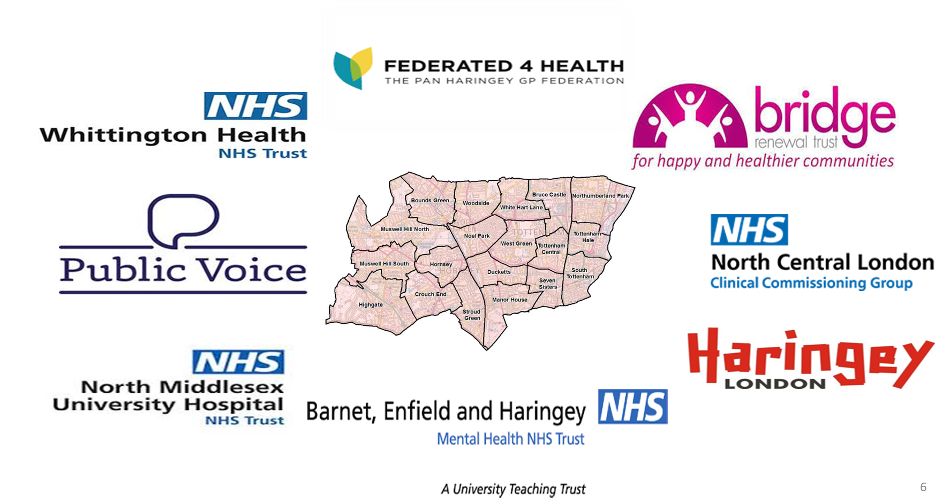
Which organisations are we talking about?

Slide 6
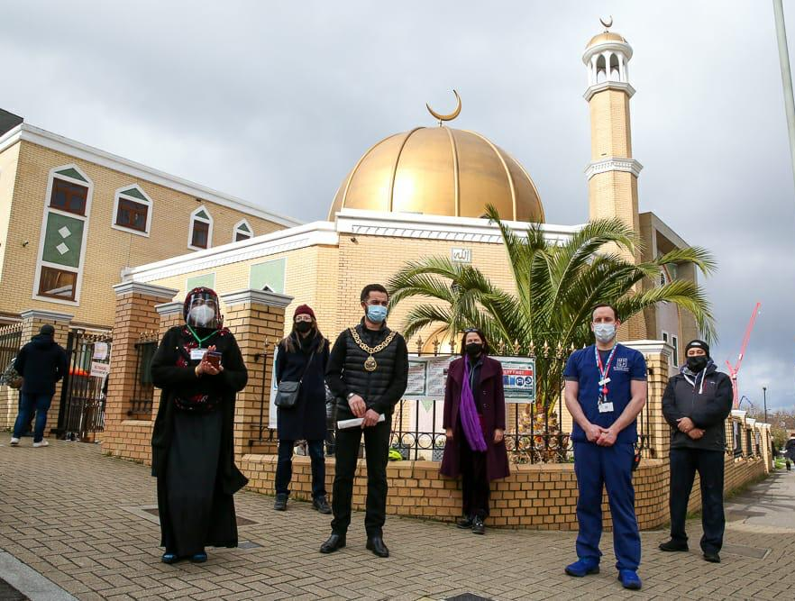
Our Integrated Care System
London Islamic Cultural Society hosts vaccination clinic
Volunteer driver service provides 800 journeys
Pop-up clinics in mosques, churches, food banks, cultural centre
Special Constable Burak Kel supports a patient

