Slide 1
PPG update
May 2021

Slide 2
80% of most at risk people have been vaccinated
Significant mistrust about the covid vaccine among some sections of the community. Royal Society of Public Health survey in December found that three-quarters of those polled would take a COVID-19 vaccine if advised to do so by a doctor, that figure fell to 57% among Black people and those from Asian and ethnic minority backgrounds. The body also said the survey “revealed significantly more hesitancy among lower income groups”
Our actions in response included the deployment of link workers, an outreach campaign including pop-up vaccination sessions, a social media campaign and a volunteer driver network. There have been about 800 volunteer driver journeys. 79.7% of people in the top four risk groups and 64% of the top ten risk groups have been vaccinated in Haringey. We think take-up is higher due to some registered patients being out of the country or inaccurate records.
In a sample of food bank users at the Selby Centre last week:
Of people in 80s (2 asked) 2 had taken vaccine
Of people in 70s (6 asked) 6 had already taken vaccine
Of people in 60s (12 asked) 11 had already taken vaccine 1 had not
Of people in 50s (13 asked) 6 had already taken vaccine 7 had not
Of people in 40s (32 asked) 18 had already taken vaccine 14 had not
Of people in 30s (14 asked) 3 had already taken vaccine 11 had not

Slide 3
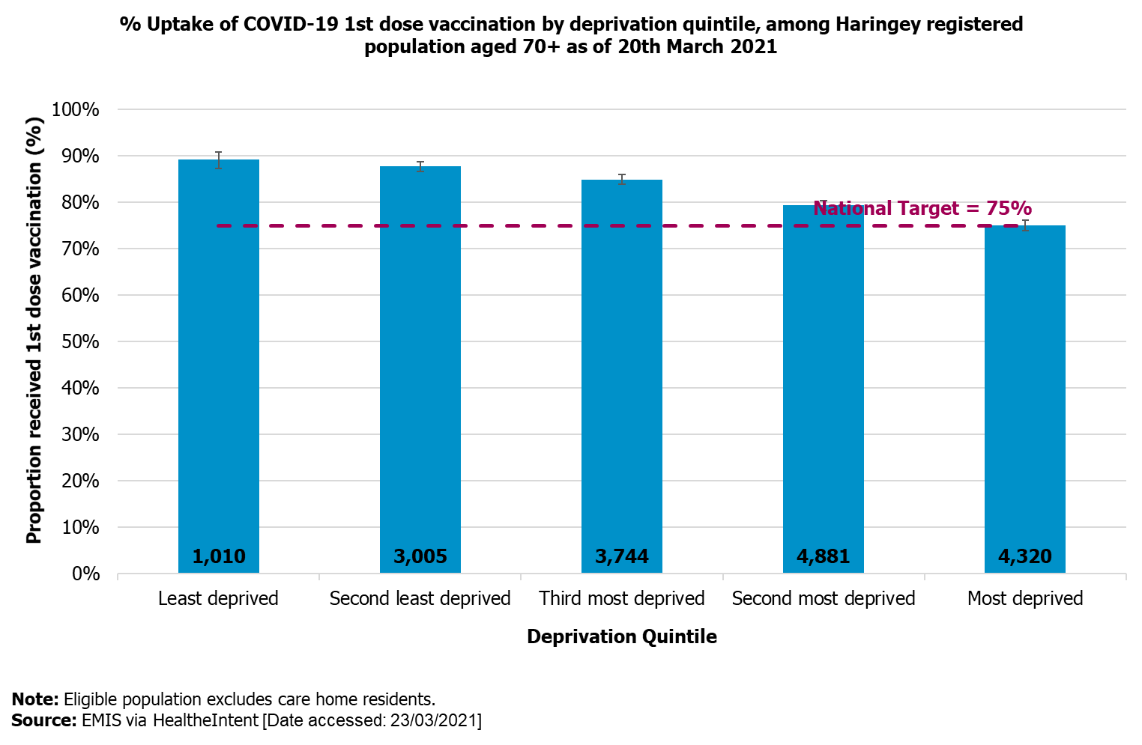
Most older people have now taken the vaccine

Slide 4
“Wait and See” argument is surely won
‘Wait’- 128,000 UK deaths. Significant number of people with long-term health damage
‘See’- 35 million people vaccinated across the United Kingdom. More than one million people vaccinated in NCL. Zero covid deaths recorded in England today.
Act Now- Social limits on meeting to end on 21st June. Scientists are predicting a third wave in July.

Slide 5
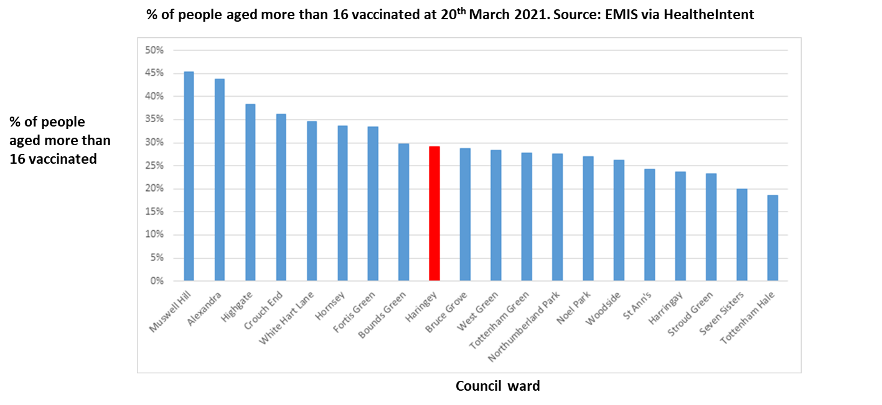
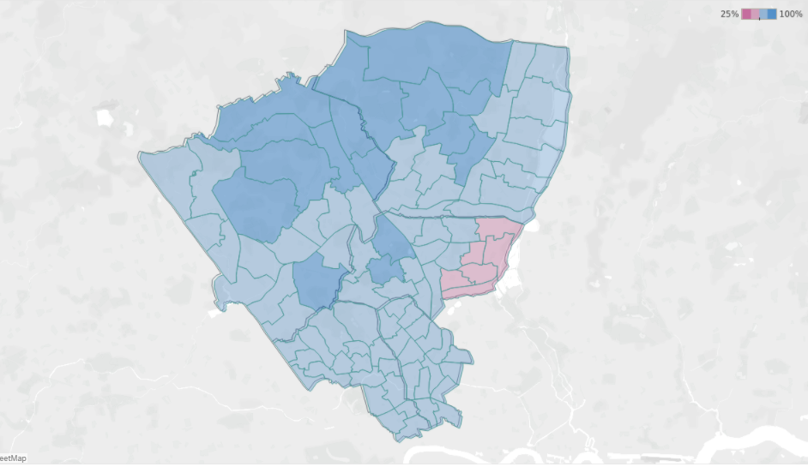
East Haringey is at risk from a third wave
We need to make a major push on getting more people vaccinated in Haringey before lockdown eases on 21st June.
Vaccine take-up by Cohorts 1-9 by ward, NCL
26th April

Slide 6
There needs to be a major push to increase vaccination rates
Encourage everyone to get vaccinated. People can be approached by their GP for an appointment at Lordship Lane or Bounds Green health centre. They can also be contacted by the national booking system and offered an appointment at a pharmacy or Hornsey Central.
Drop-in vaccination sessions for people aged over 40 and first vaccinations:
Sunday 16th May from 1.30pm to 5pm at Lordship Lane Health Centre, 239 Lordship Lane, London, N17 6AA
  Thursday 27th May from 1pm to 4pm at Eric Allin Community Centre, Kenneth Robbins House, Northumberland Park, London N17 0QA
  Training course on positive conversations about the vaccine:
    This Wednesday 12th May at 19.30; contact cameron@bridgerenewaltrust.org.uk
    Thursday 20th May at 1pm; contact Aaishah.Ahmed@haringey.gov.uk

