Slide 1
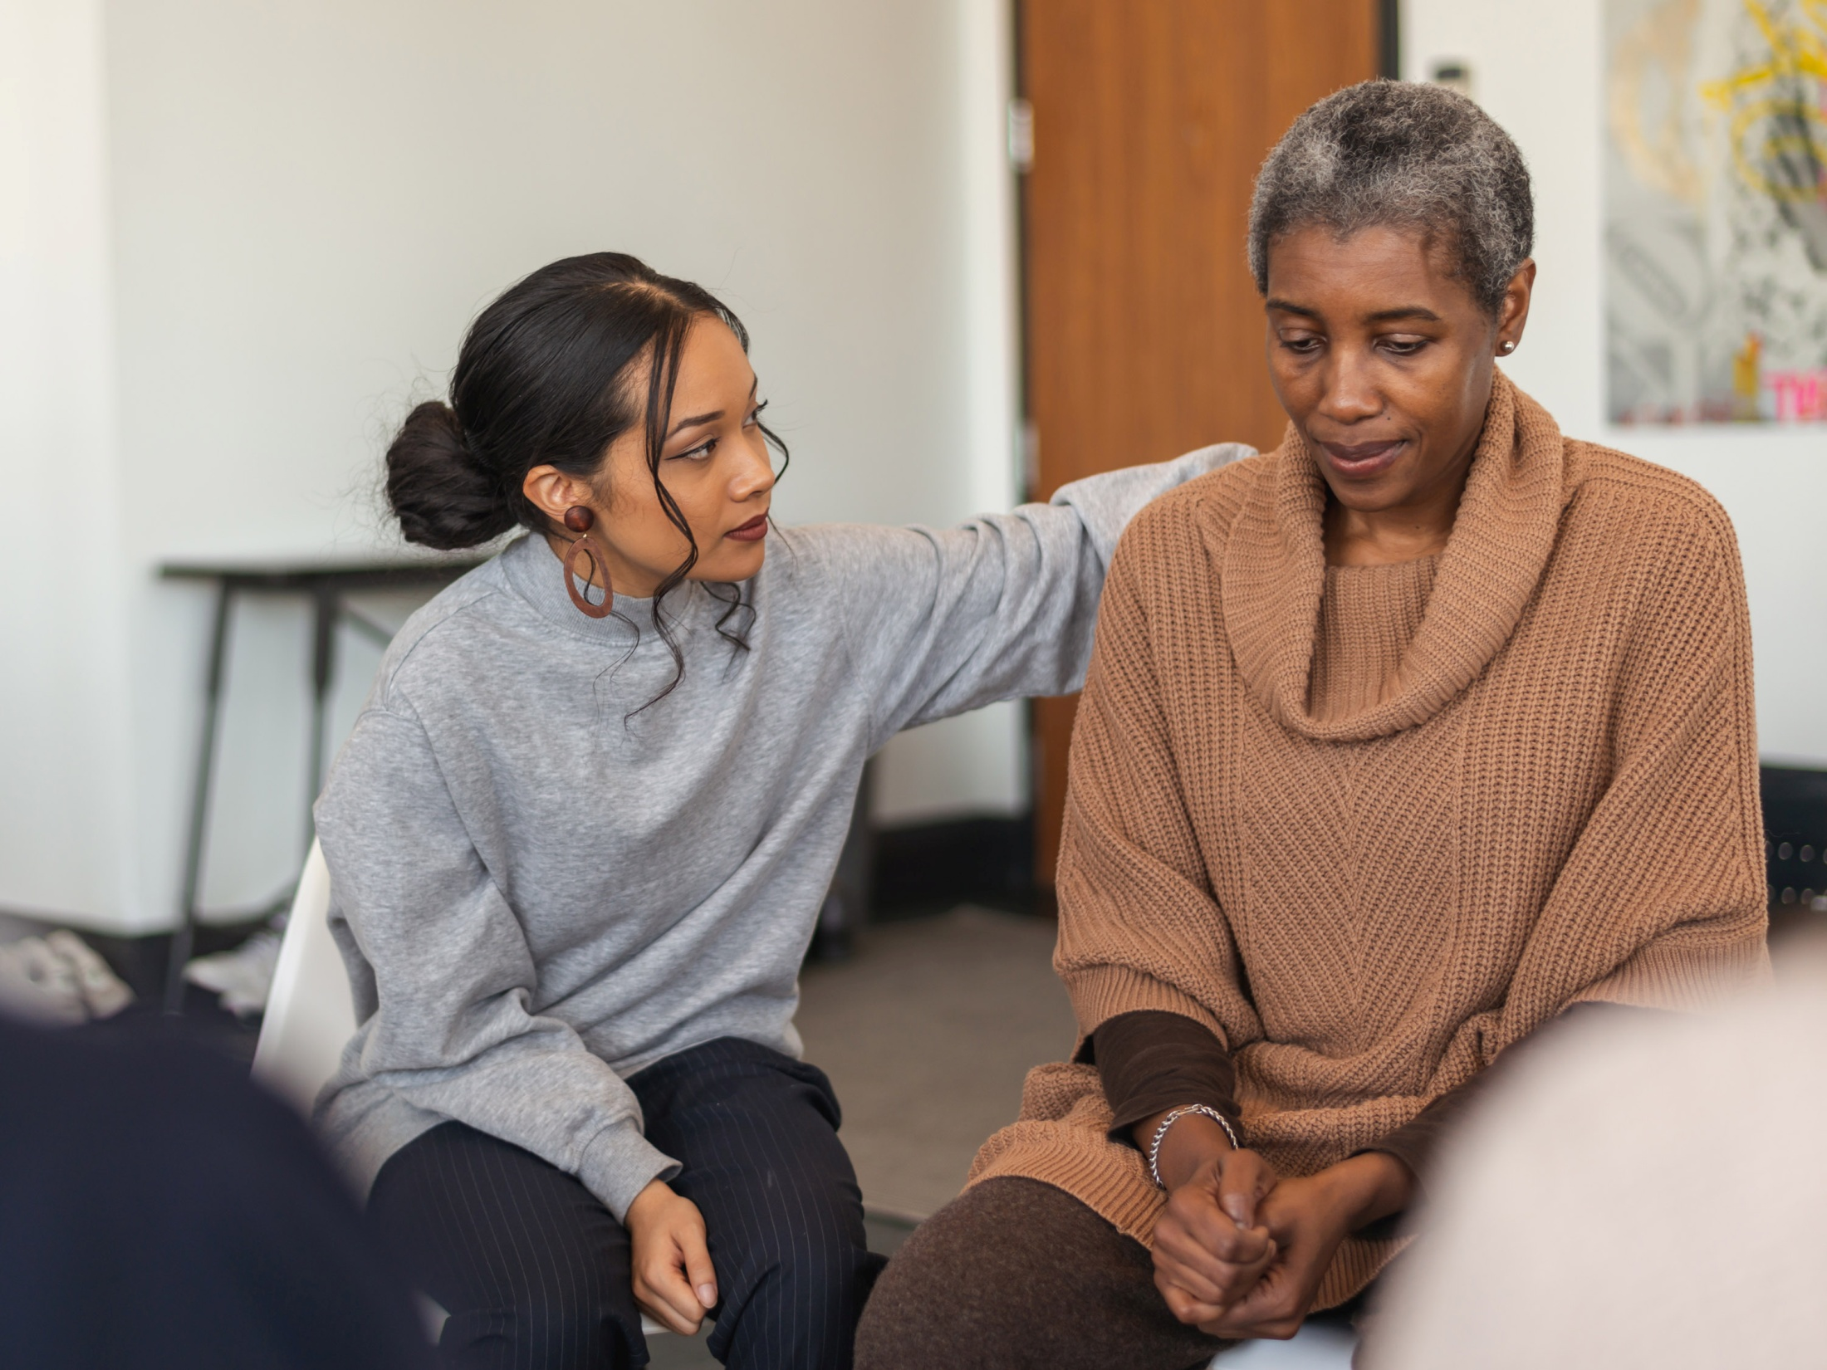


Long COVID report
People’s Experience of Long COVID in Haringey

Slide 2
Why we wanted to find out about Long COVID
Currently there are three million people (3.1% of the population) living in private households with Long COVID in the UK
826,000 people have had Long COVID for more than 12 months
Long COVID can have a devastating impact on people’s physical and mental health, their ability to work, their education and their day-to-day lives

Slide 3
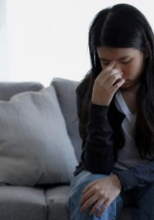
Haringey Long COVID project
Follows on from the Five Local Healthwatch Long COVID report.
Haringey, Enfield, Barnet, Islington, and Camden
Survey and interviews
We aimed to capture local people’s experiences of Long COVID:
to identify any gaps in current service provision, and
improve local services to better help and support local people living with Long COVID.

Slide 4

Participants
  We gathered 300 local peoples’ experiences of Long COVID across North Central London
  21 of the survey respondents came from Haringey
  We interviewed four of the Haringey respondents to find out more

Slide 5
Key findings – Employment and finances
Long COVID badly affected people's ability to work, leading to some people having to reduce their working hours or stop working
15 out of 21 respondents (71%) said Long COVID had impacted on their ability to work or the number of hours they can work
Two people were made redundant

Slide 6
It has put me on universal credit. I am self-employed and having Long COVID meant that I accrued a work
debt that I am still trying to pay off.
I was unable to claim for a self-employment grant or anything similar because I didn’t fit the narrow criteria.
  Haringey Resident

Slide 7
Recommendations – Employment and finances
Statutory services (Haringey Council, NCL CCG, and NHS Trusts) should model being a good employer for people living with Long COVID.
HR departments should ensure reasonable adjustments are made, and flexible working arrangements explored, to ensure people can keep their jobs and continue to work
Information, help and support should be provided to people living with Long COVID to ensure they are able to access any benefits they are entitled to

Slide 8
Key findings – Physical health
16 out of 21(76%) respondents said their physical health had been impacted by Long COVID
They reported significant, wide ranging, multiple and severe physical health impacts.

Slide 9
At the age of 35, I’m not able to live a normal life. I’m in so much pain and I’m so exhausted that all I can do is force myself to work from home and stay in bed.
All the joy is gone, there is only pain, exhaustion and anticipation of more pain.
I used to be an active smart person now due to the brain fog I feel like an idiot most of the time.
  Haringey Resident

Slide 10
Key findings – Mental health
Developing Long COVID had a significant impact on mental health and wellbeing
14 out of 21 respondents (67%) felt an impact on their mental health and their ability to do things they enjoyed
People reported feeling depressed and suffering from anxiety

Slide 11
I’ve been exhausted for 11 months and it has been a struggle to do daily life maintenance tasks such as cleaning, changing the duvet covers, hoovering. My normally very active social and cultural life has been reduced enormously and I have become somebody who watches TV most nights having not watched TV for 30 years!
  Camden Resident

Slide 12
Key findings - Diagnosis
Some people experienced difficulty getting a diagnosis of Long COVID from their GP or clinician
Seven of the 15 respondents (47%) said their GP / clinician had little or no knowledge about Long COVID.
GPs lack of knowledge about Long COVID was a recurring theme

Slide 13
I know that it’s a new illness and it’s so difficult to know what to do, but I am so frustrated and upset, it feels hopeless as I’ve not been offered anything that’s helped me so far. One doctor told me it’s all psychological and it’s down to the patient to figure out what to do for themselves.
  Haringey Resident

Slide 14
Looking at national trends, there should be more than 3,000 Haringey residents diagnosed with Long COVID. But currently there are only around 900 and most appear to be in the West of the borough. This points to a real problem of undiagnosed Long COVID in the more deprived East of the borough.
  Haringey Long COVID report

Slide 15
Recommendations - Diagnosis
Explore and address the issue of undiagnosed Long COVID amongst Haringey residents, particularly focusing on the more deprived East of the borough
More training for GPs so they are able to recognise Long COVID symptoms, provide a diagnosis, provide the patient with good quality information, and refer on appropriately

Slide 16
Key findings – Healthcare
13 of the 21 respondents (62%) had experienced difficulties in getting appropriate healthcare support
15 of the 21 respondents (71%) had to do their own research on Long COVID, due to the lack of support from the NHS, including unsympathetic GPs, ineffective advice, long waits for diagnosis and long waits for the Long COVID clinic
Respondents talked about inequality of access to Long COVID health services, especially for those from diverse backgrounds or from disadvantaged communities. Those less able to advocate for themselves may not receive the care and support they need

Slide 17

Recommendations – Healthcare - Support
Patients diagnosed with Long COVID should be given information and advice on appropriate self-management techniques and resources
Develop Haringey based in-person and online peer support groups for people living with Long COVID
Develop a phone helpline to provide information and support on Long COVID, so people do not feel so isolated

Slide 18
Recommendations – Healthcare – Long COVID pathway
Ensure patients waiting for their first appointment with the Long COVID clinic at least get a phone call or an email providing good quality patient information on Long COVID eg. self-management techniques, helplines, local support groups, so they are able to access help and support whilst they are waiting
Ensure there is more consistency in people’s experiences accessing the Long COVID pathway, taking into account patients’ physical, mental and social needs

Slide 19
Recommendations – Healthcare
Public Health
Continue to analyse and monitor Long COVID data for Haringey residents across localities and communities to help ensure Long COVID support and services are being accessed by all localities and communities in an equitable way
Communications
Develop effective communications around Long COVID for patients, raising awareness of what it is, and encouraging people to seek medical advice and help

Slide 20
For more information
  Healthwatch Haringey
  Tottenham Town Hall
  Town Hall Approach Road
  N15 4RX
  http://www.healthwatchharingey.org.uk/
    t: 020 8888 0579
    e: info@healthwatchharingey.co.uk
    @HWHaringey
    Facebook.com/HealthwatchHaringey

