Slide 1

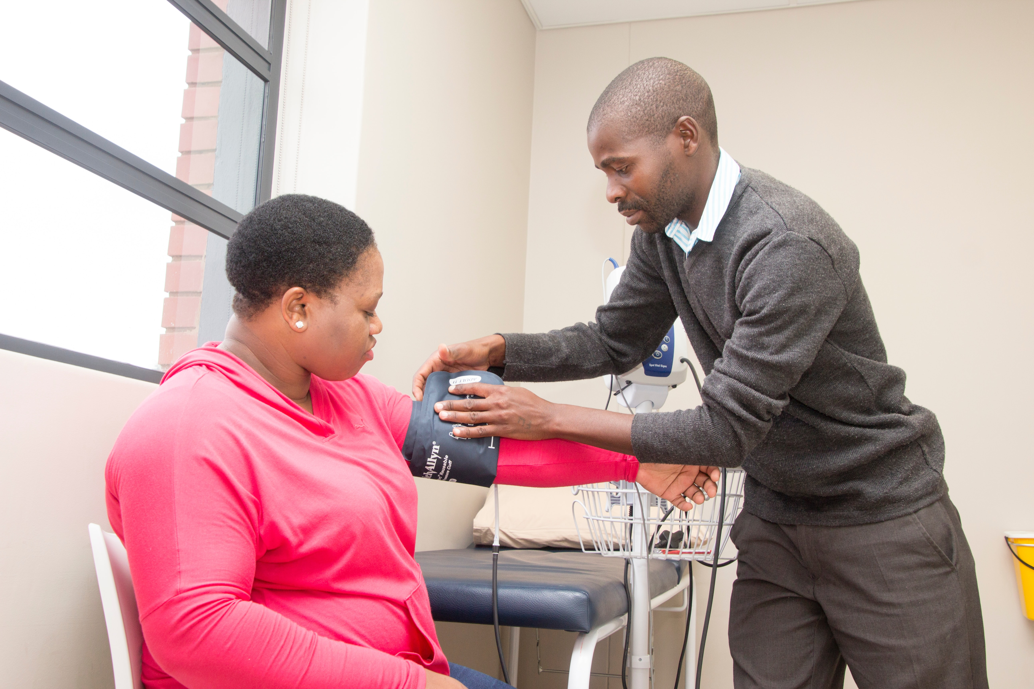

GP Stocktake
Samir Hakim, Research Officer
Raks Patel, Research and Engagement Manager
February 2022

Slide 2
Methodology
Healthwatch Haringey carried out a GP stocktake (November 2021 to January 2022)
We covered all 40 GP practices in Haringey
We looked at phone systems and websites
Methodology based on:
the mystery shopping exercise we did last year,
our work on GP services over the last 2 years, and
work by other local Healthwatch on GP services over the last 2 years
Calling Haringey GP practices assessing waiting times, queuing systems, recorded messages, and appointment systems.
Reviewing Haringey GP practice websites on how easy it was to find key information, how up-to-date information was, how accessible and user-friendly they were, and on online systems used.
Mystery Shopping
Website Reviews

Slide 3
Phone calls
Key Findings
Morning Calls (8am – 10am)
Afternoon Calls (12pm – 5pm)
01
Answered Calls
Median time to answer = 3 minutes
Mean time to answer call = 5 minutes
01
Answered Calls
Median time to answer = 3 minutes
Mean time to answer = 6 minutes
02
Good Practice
14 calls (35%) were answered in under 2 minutes
20 calls (50%) answered in under 3 minutes
02
Good Practice
15 calls (37.5%) answered in under 2 minutes
16 calls (40%) answered in under 3 minutes
Unanswered Calls
5 calls (12.5%) we could not get through to the practice:
2 calls phone was cut off after ringing, message and then a period of time
3 calls we were waiting for 30 minutes so we hung up
03
Unanswered Calls
6 calls (15%) we could not get through to the practice:
4 calls phone was cut off after ringing, message and then a period of time
2 calls we were waiting for 30 minutes so we hung up
03
04
Longest Times to Answer
Longest times to answer 15 minutes, 21 minutes, 24 minutes
04
Longest Times to Answer
Longest times to answer = 22 minutes, 24 minutes, 26 minutes

Slide 4
Phone systems & appointments
Key Findings
Queuing Systems
Booking an Appointment
30 (75%) GP practices had a queuing system
10 (25% ) GP practices did not have a queuing system
16 (40%) GP practices only offer same-day appointments with the patient having to call in the morning

Slide 5
Phone calls, systems & appointments
Recommendations
Long Waiting Times
Practices with long waiting times to answer phones to review ways of working / systems with a view to bringing these waiting times down
Dropped calls
Practices with dropped calls to follow this up
Queuing Systems
Practices who do not have a queuing system to introduce one letting patients know where they are in the queue
Future Appointments
Practices to offer patients future appointments, that can be made throughout the day – avoid asking patients to call in at 8am every day (not everyone can call at 8am, and some people never get an appointment and have to call in day after day)

Slide 6
Websites
Key Findings
01
Key information
04
Search Bar
All GP practices have a website, listing their location, phone number, opening hours, and containing up-to-date information
16 (40%) GP practices do not have a search bar on their website
Out of hours
02
Current Covid-19 advice
05
37 (93%) GP practices signposted people on to 111
15 (38%) GP practices signposted on to the Haringey out-of-hours service
3 (7.5%) GP practices do not display current Covid-19 advice
03
Email
06
Feedback and complaints
17 (43%) GP practices do not have a general email address where patients can contact the practice
8 (20%) GP practices do not have a feedback form or advice on how to make a complaint

Slide 7
Websites: Accessibility,
Equality & Inclusion
Interpreting services
15 (38%) GP practices do not mention interpreting services
Translation function
16 (40%) GP practices do not have a translation function on their website (eg. google translate), and 2 (5%) GP practices only offer translation into French and German
01
03
Disability information
25 (63%) GP practices do not mention disability access including information on wheelchair access and British Sign Language interpreters
Safe Surgeries Banner
6 (15%) GP practices display a safe surgeries banner/information
16 GP practices have signed up to the initiative
02
04

Slide 8
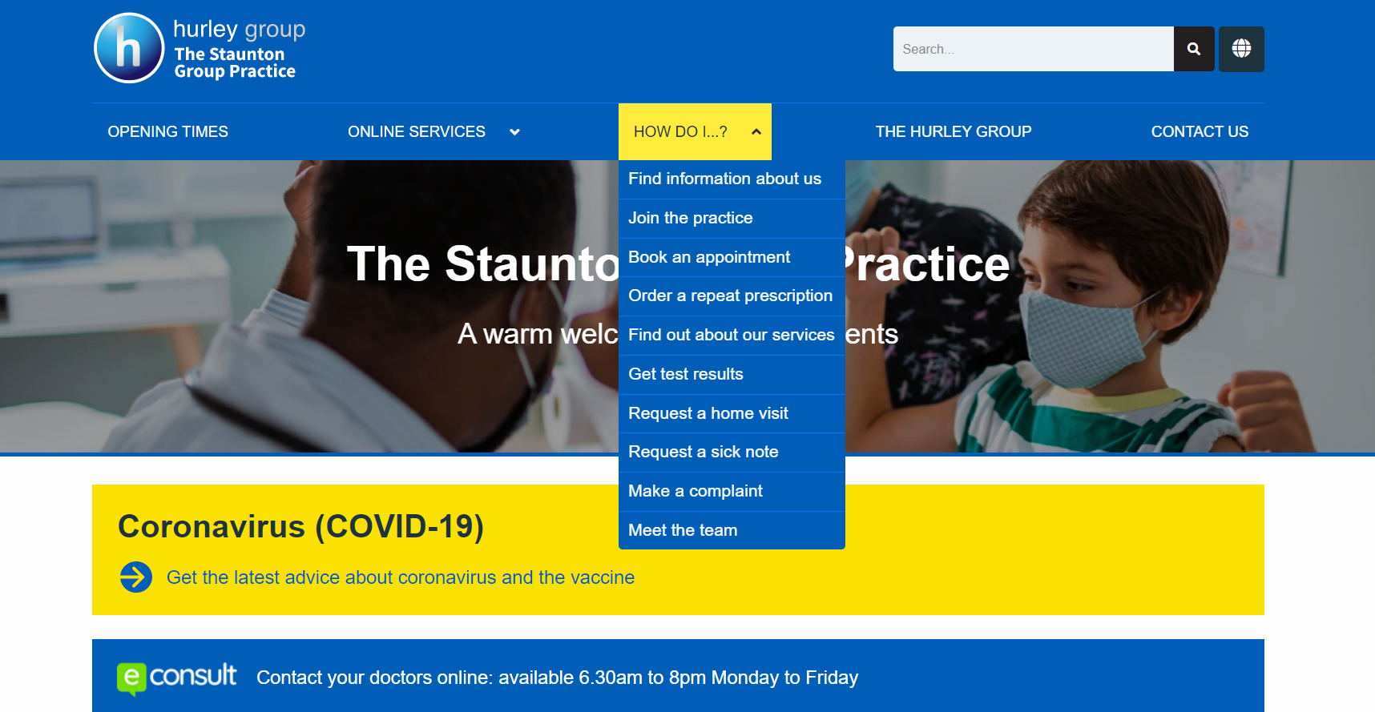
Good practice example:
Website
#1
The presentation of the website is concise and clear
#4
The website has a translation function
#2
The language used on the website is understandable and reflects patient questions
#5
The website has
a search bar
#3
The website has a link to the latest Covid-19 advice
#6
The website has a link to the online service Econsult

Slide 9
Websites
Recommendations
User Friendly
Ensure your website is accessible, intuitive, user-friendly and in plain English
Out of Hours
Carry information regarding the Haringey out of hours services AND the 111 service
Search function
Include a search function on your website
Covid-19 advice
Display current Covid-19 advice
Other methods of contacting the practice
Feedback and Complaints
Offer patients alternative methods of contacting the practice if they can’t get through on the phone e.g. provide an email or allow patients to visit reception in person
Have information on how patients can provide feedback and make a complaint

Slide 10
Websites: Accessibility,
Equality and Inclusion
Recommendations
Interpreting
Provide information on interpreting services
Safe Surgeries
Sign up to the Safe Surgeries initiative
Display the Safe Surgeries banner
Translation
Include a translation function on your website
Disability information
Provide information for people with disabilities eg wheelchair access, BSL

Slide 11
Contact Us
Website
www.healthwatchharingey.org.uk.
Email
info@healthwatchharingey.org.uk
Twitter
@HWHaringey
Phone
020 8888 0579

