Slide 1
GP Community Pharmacy Consultation Service patient pathway
Efa Mortty
Interim Head of Medicines Management
Haringey Borough Directorate Feb 2022

Slide 2
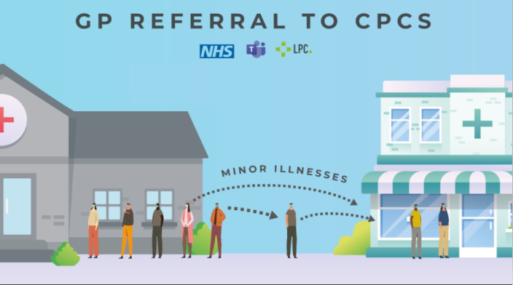
What is GP CPCS?
Implementation is locally led but nationally supported
Key aims include:
Help to alleviate pressure on general practice
Improve access for patients
Promotes self-care
Strengthen relationships between general practice and pharmacy

Slide 3
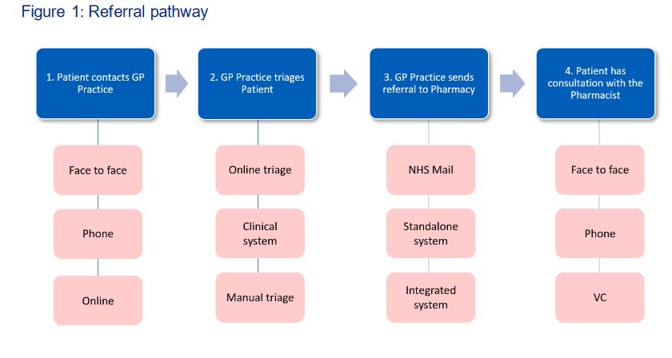
Patient Pathway

Slide 4
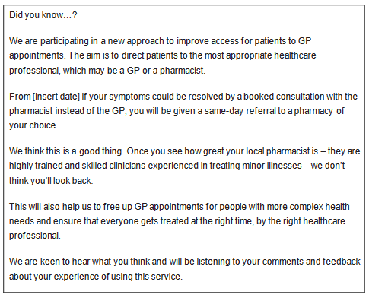
Patient Comms – practice website digital screens or printed information suggestion

Slide 5
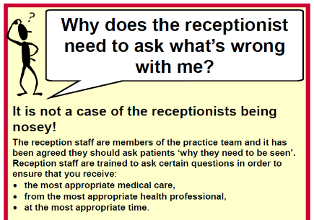
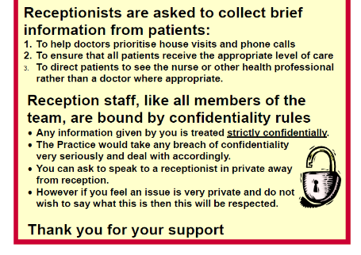
For display in the practice
Poster about the role of reception teams

Slide 6
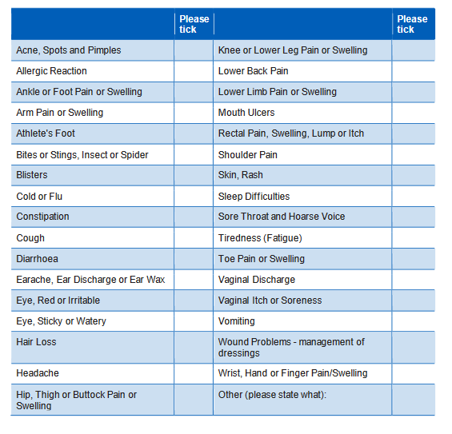
List of conditions on NHSE website
NOTE: Individual practices will determine which symptom groups they will refer to
pharmacy.

Slide 7
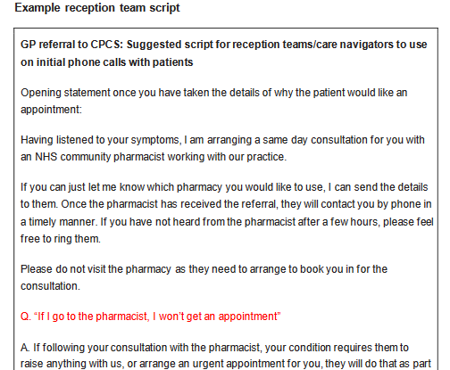
Suggested script for reception staff

Slide 8
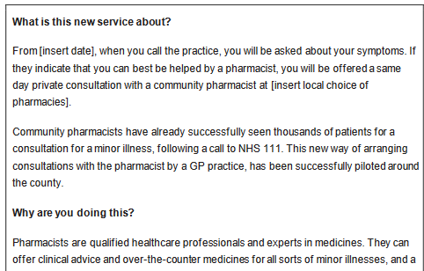
Suggested Q&A for patients for use on GP website

Slide 9
Questions?

