Slide 1
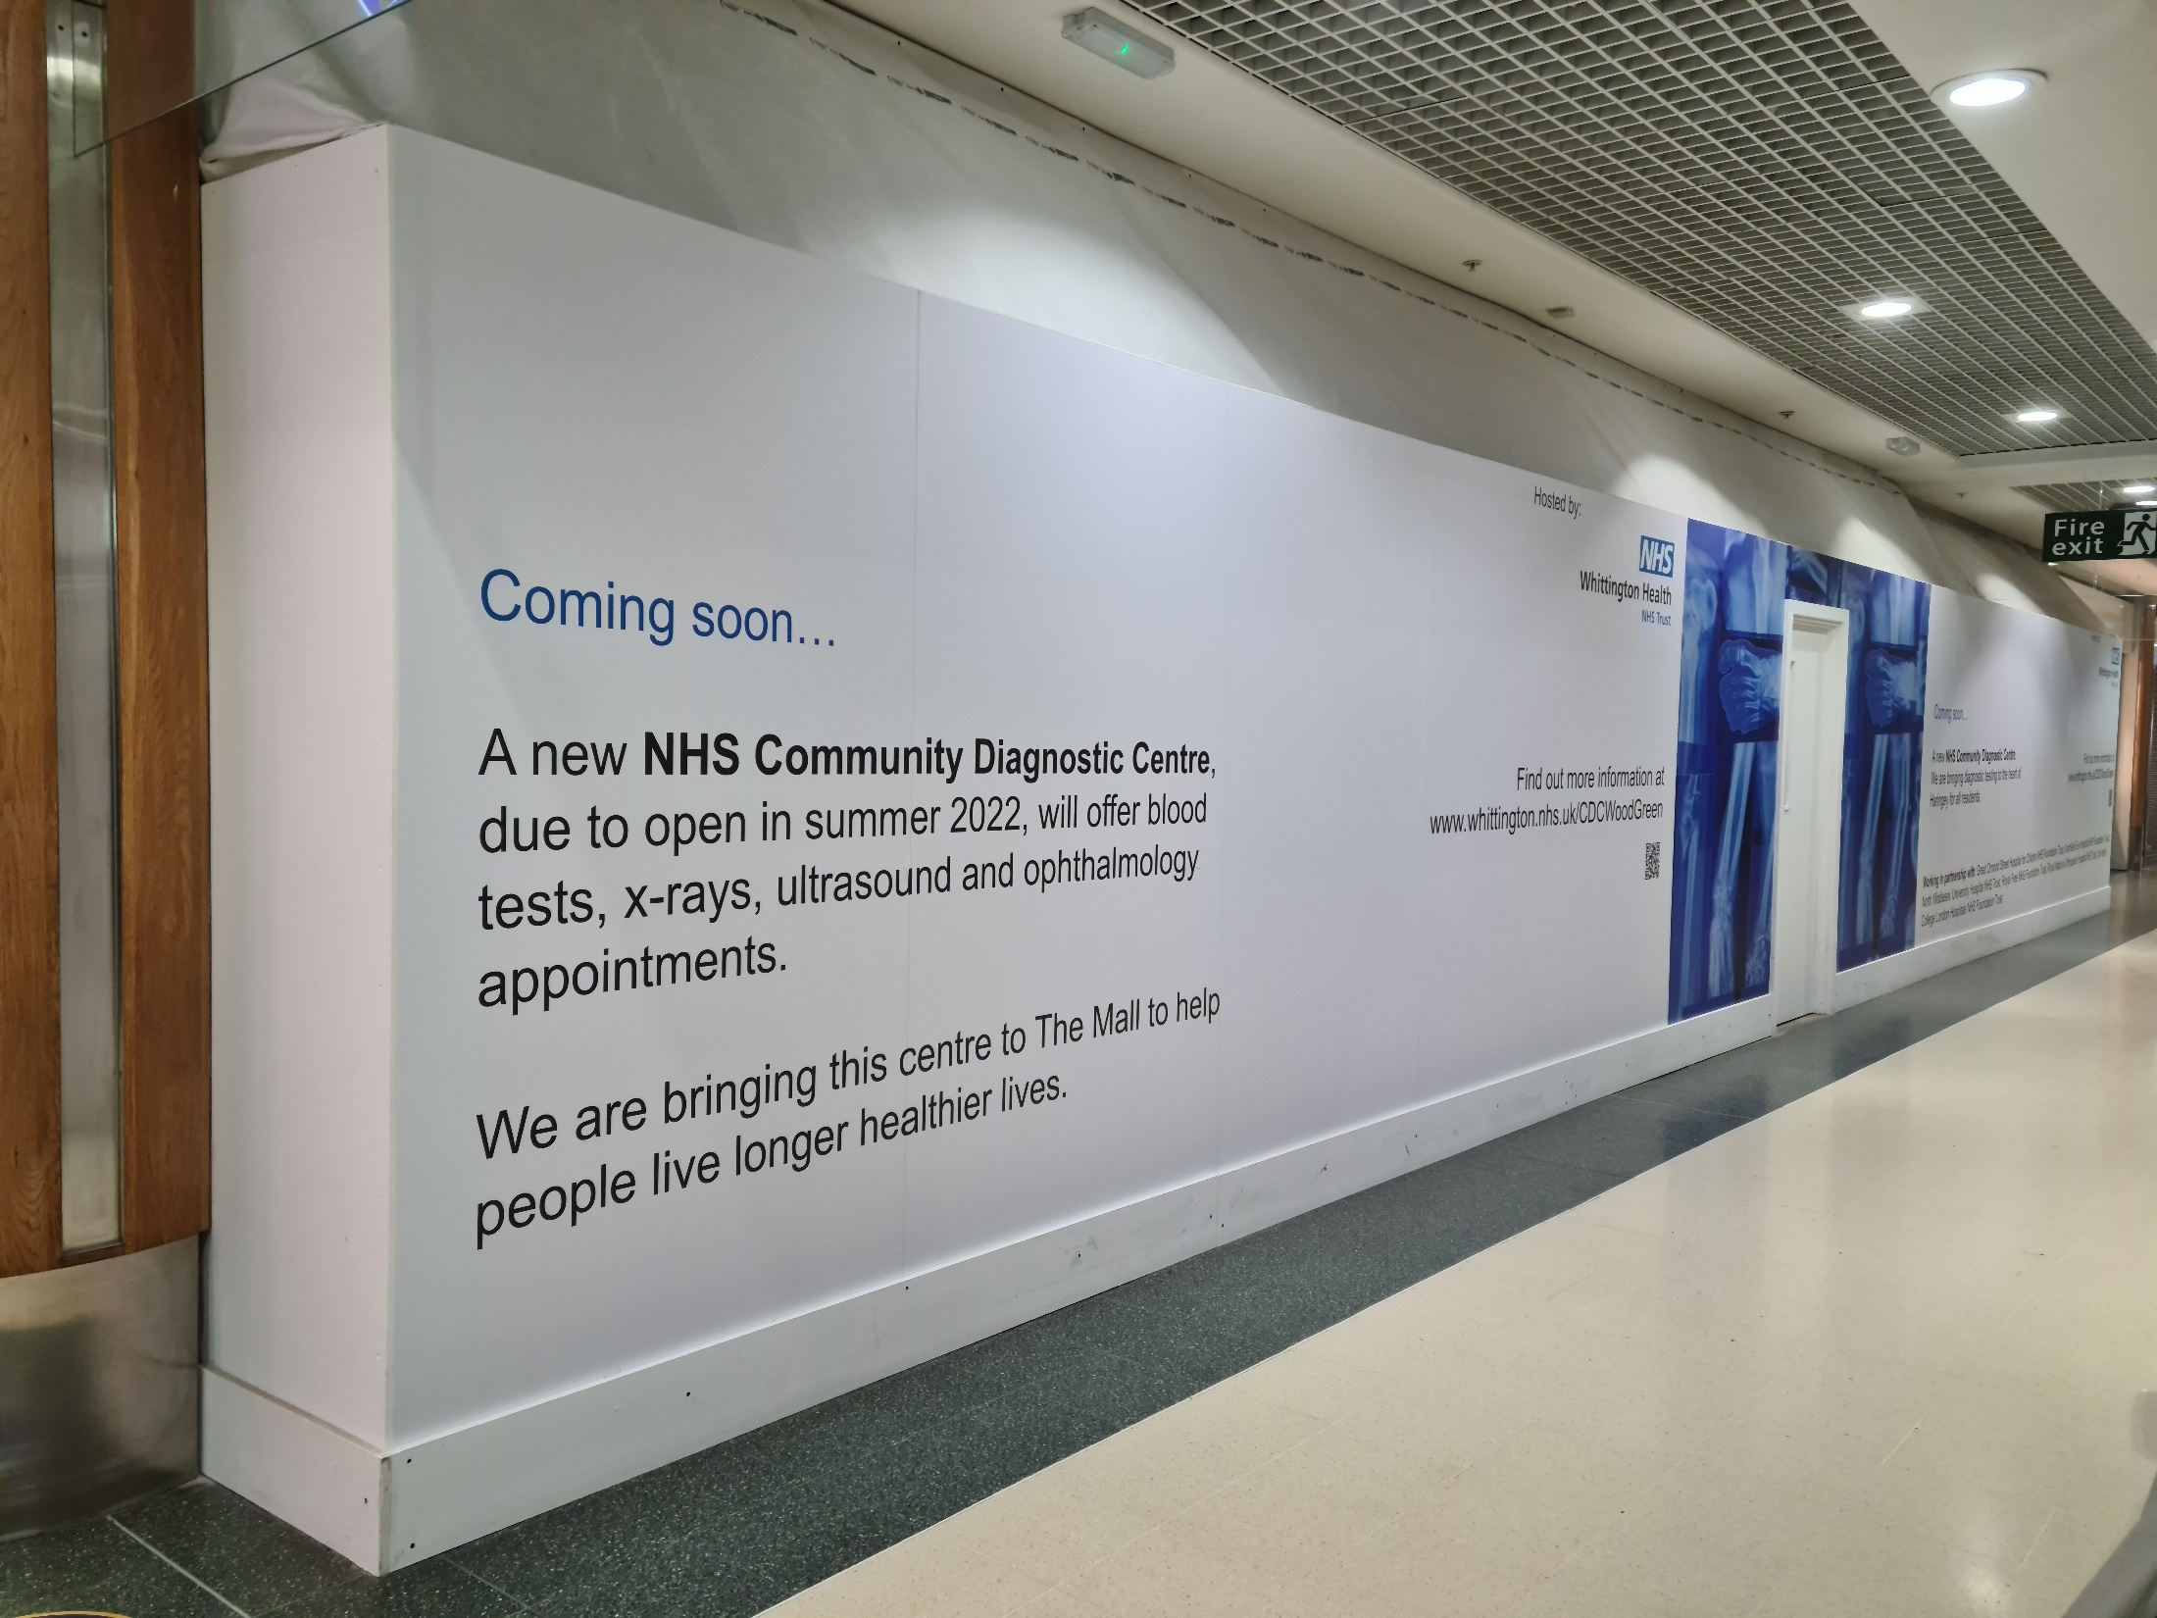
Wood Green Community Diagnostic Centre

Slide 2
What will the CDC offer?
Blood tests
X-ray
Ultrasound
Ophthalmology

Slide 3
What will the CDC offer?
Blood tests
X-ray
Ultrasound
Ophthalmology

Slide 4
How you can keep informed
Visit www.whittington.nhs.net/cdcwoodgreen
Email WoodGreenCDC.whitthealth@nhs.net
Call and leave a voicemail on 020 7288 5674 – we will get back to you within five working days

